Slide 1

Major project under the guidance of M. Muni Babu M. Tech, (Ph. D) Assistant Professor
RAJIV GANDHI UNIVERSITY OF KNOWLEDGE TECHNOLOGIES
(Catering the Educational Needs of Gifted Rural Youth of AP)
RK Valley, Kadapa (Dist.), Andhra Pradesh, 516330
Department of Computer Science and Engineering

Slide 2
B.HARIKA
R180503 Role : Robotic Process Automation(RPA) Intern Company : Algonox

Slide 3




ALGONOX
Algonox is founded by accomplished technologists with the idea of empowering organizations with emerging technological advancements. Established in early 2017, we are young and growing at a rapid pace in Banking & Financial Services, Retail, Pharma domains and also industry-agnostic sectors like finance & accounting, Human resources, etc. Our core vision is to provide seamless Cognitive Automation solutions & capabilities to enterprises across industries & domains and be a part of their digital transformation.
Scalable: Built on Microservices architecture, enabling horizontal scaling and quick new features addition.
Configurable: Low code and configurable through and through- from user layout to process workflows.
Flexible: Offers On-prem, On-cloud, Managed service deployments.
Fastest ROI: 4 week deployment with highest yield in ROI.

Slide 4
AGENDA
Introduction to UI Path Studio
Automation Workflow in UI Path Studio
Advantages
Activities in UI Path Studio
Tasks
Conclusion
Future Enhancement

Slide 5

Introduction To UiPath Studio
UiPath Studio is a powerful, user-friendly platform that enables businesses to automate a wide range of repetitive tasks and workflows. This comprehensive introduction will explore the key features, capabilities, and benefits of UiPath Studio, equipping you with the knowledge to harness the power of Robotic Process Automation (RPA).

Slide 6
Automation Workflows in UiPath Studio
Design Visually create automation workflows.
Build Implement complex business logic and integrations.
Deploy Publish and schedule automations for execution.

Slide 7
ADVANTAGES
Improved Efficiency and Productivity
Better accuracy and quality
Cost Savings and ROI
Scalability
Flexibility

Slide 8
Activities in UiPath Studio
Message Box
Input Dialog
If
Else if
For Each
Sequence
Flow Chart
Log Message
Click
Write cell
Read range workbook
Add data column
Update row item
Filter Data Table
Excel application scope
Insert or Delete Column
Assign
Multiple Assign

Slide 9
TASK-1
We have an Excel sheet with four columns Name, Id, Age, and Address. We have to add a status column to the sheet. Based on age we have to update the values in the status column.
Condition :
Age>=24 “success” otherwise “failed”.

Slide 10
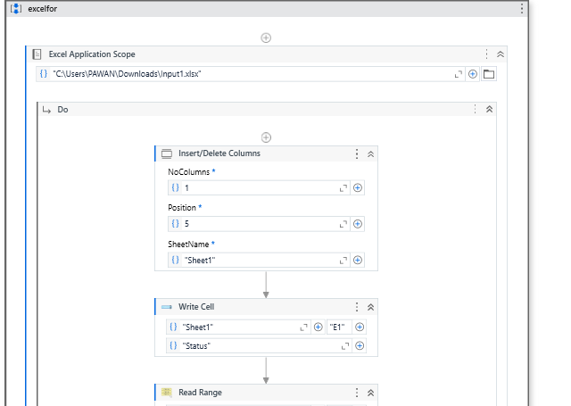
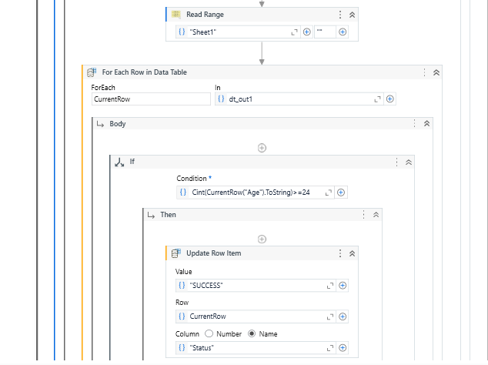

Slide 11
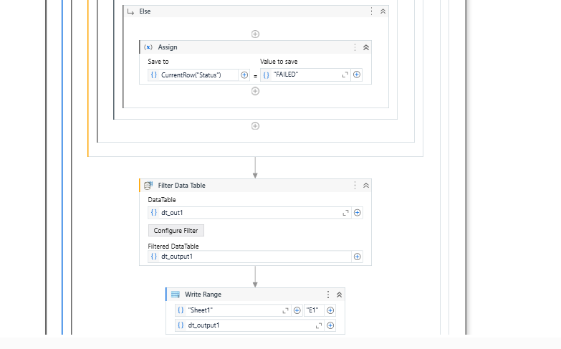

Slide 12
TASK-2
We Have an Excel sheet with four columns Name, Age, Paper1, Paper2. we have to add a total column and remarks column based on marks in Paper 1, and Paper 2. We have to print the output with six columns in another sheet.
Conditions:
If paper1 and paper2 both columns contain marks we should add a total of two paper marks and update in total column.
If paper1 is null or contains integers then we have to update in remarks invalid marks in paper1 and the total is paper2 marks.
If paper2 is null or containing non integers then we have to update in remarks invalid marks in paper2 and the total is paper1 marks.

Slide 13
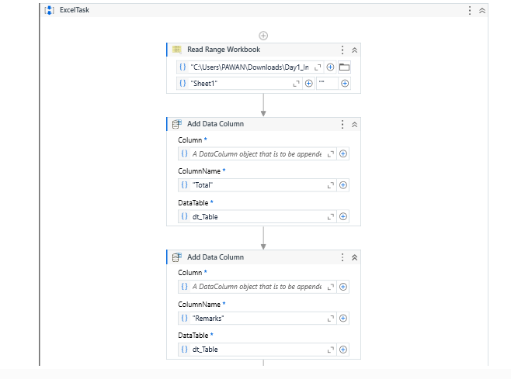
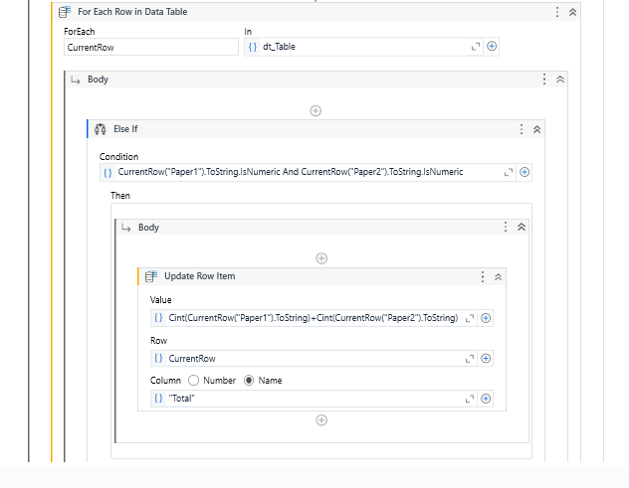

Slide 14
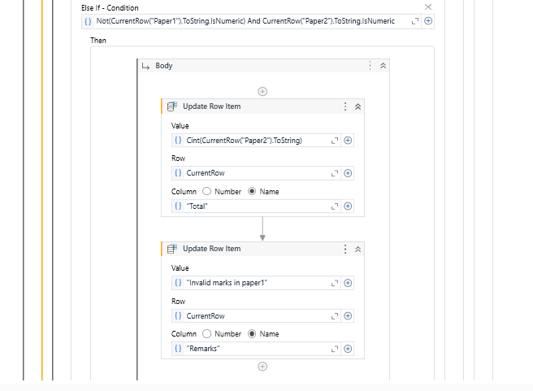
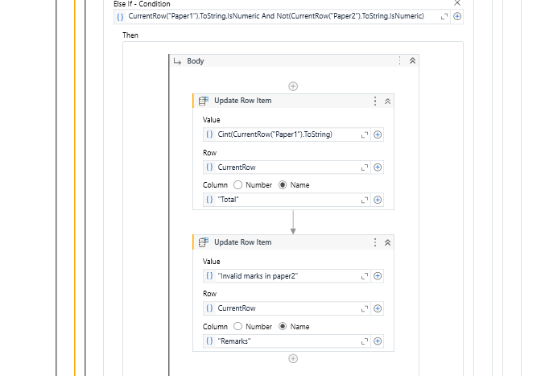

Slide 15
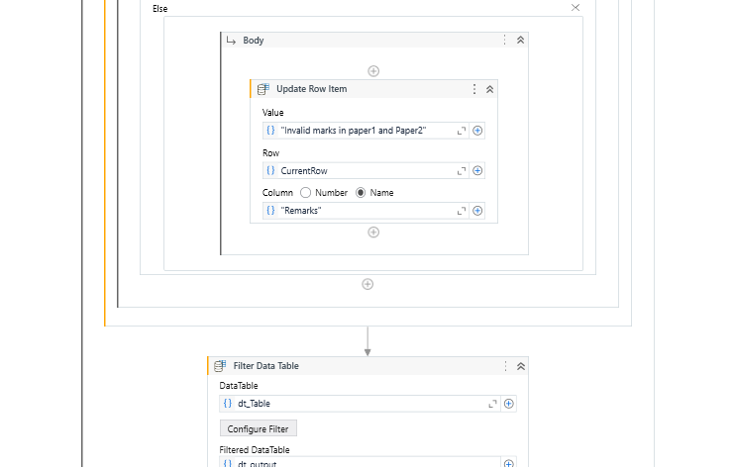
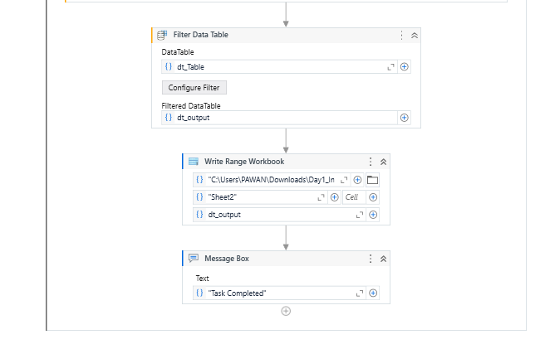

Slide 16
TASK-3
Read the Excel sheet and store it in the data table.
Checking the existence of mandatory columns in sheet 1 and sheet 2 we have to add status and remark column in sheet1.
Conditions:
If columns exist, check the reference id’s in sheet1 & sheet 2 if the reference ID in sheet1 matches the reference ID in sheet2 then update the status column in sheet1 based on result column in sheet 2.
If Reference id’s are not match then update the Remarks column in sheet1 with the value Reference id is missing.

Slide 17
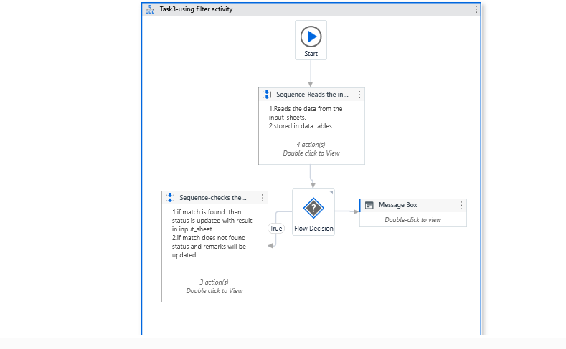
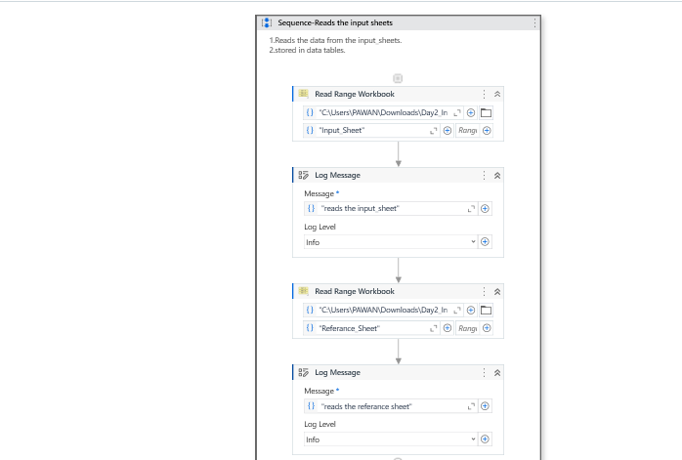

Slide 18
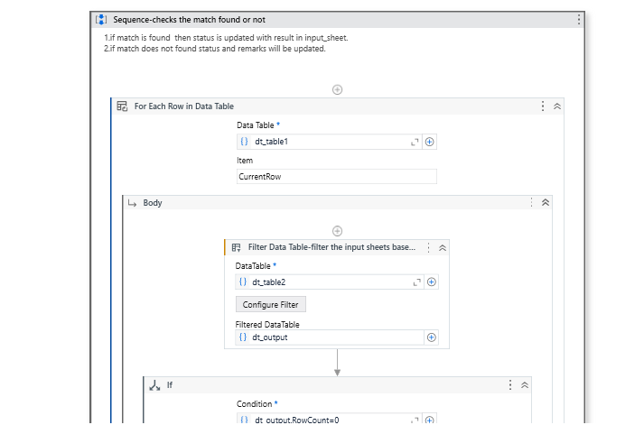
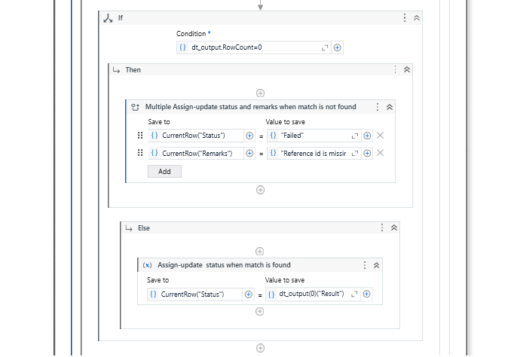

Slide 19
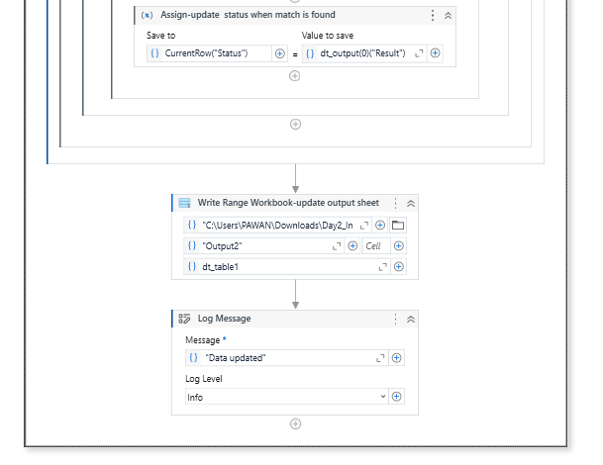

Slide 20
Conclusion
Increased efficiency, reduced errors, and cost savings.
Scalable automation across the organization.
Streamlined workflows and improved productivity.
It is user-friendly interface.
UiPath Studio will undoubtedly play a central role in shaping the future of work and business operations.

Slide 21
FUTURE ENHANCEMENT
Explore UiPath documentation and tutorials.
Identify automation opportunities in your business.
Start building your first UiPath automation project.
Expanded Cloud Integration.
Low-Code/No-Code Enhancements.

Slide 22


